Slide 1
LNHS Student Services Presentation
PTSA October Meeting 2021

Slide 2
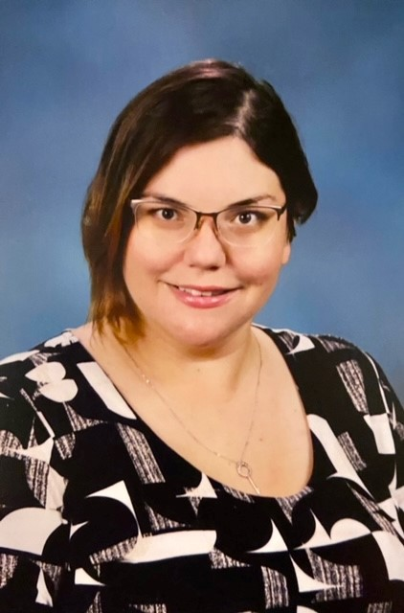
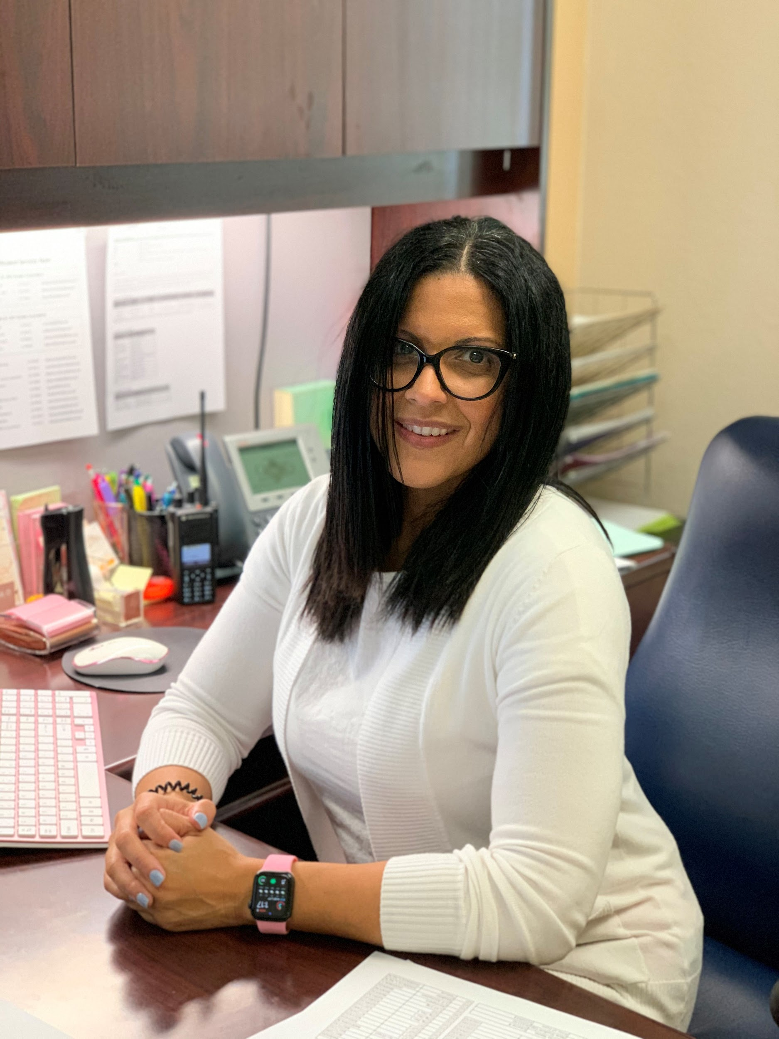
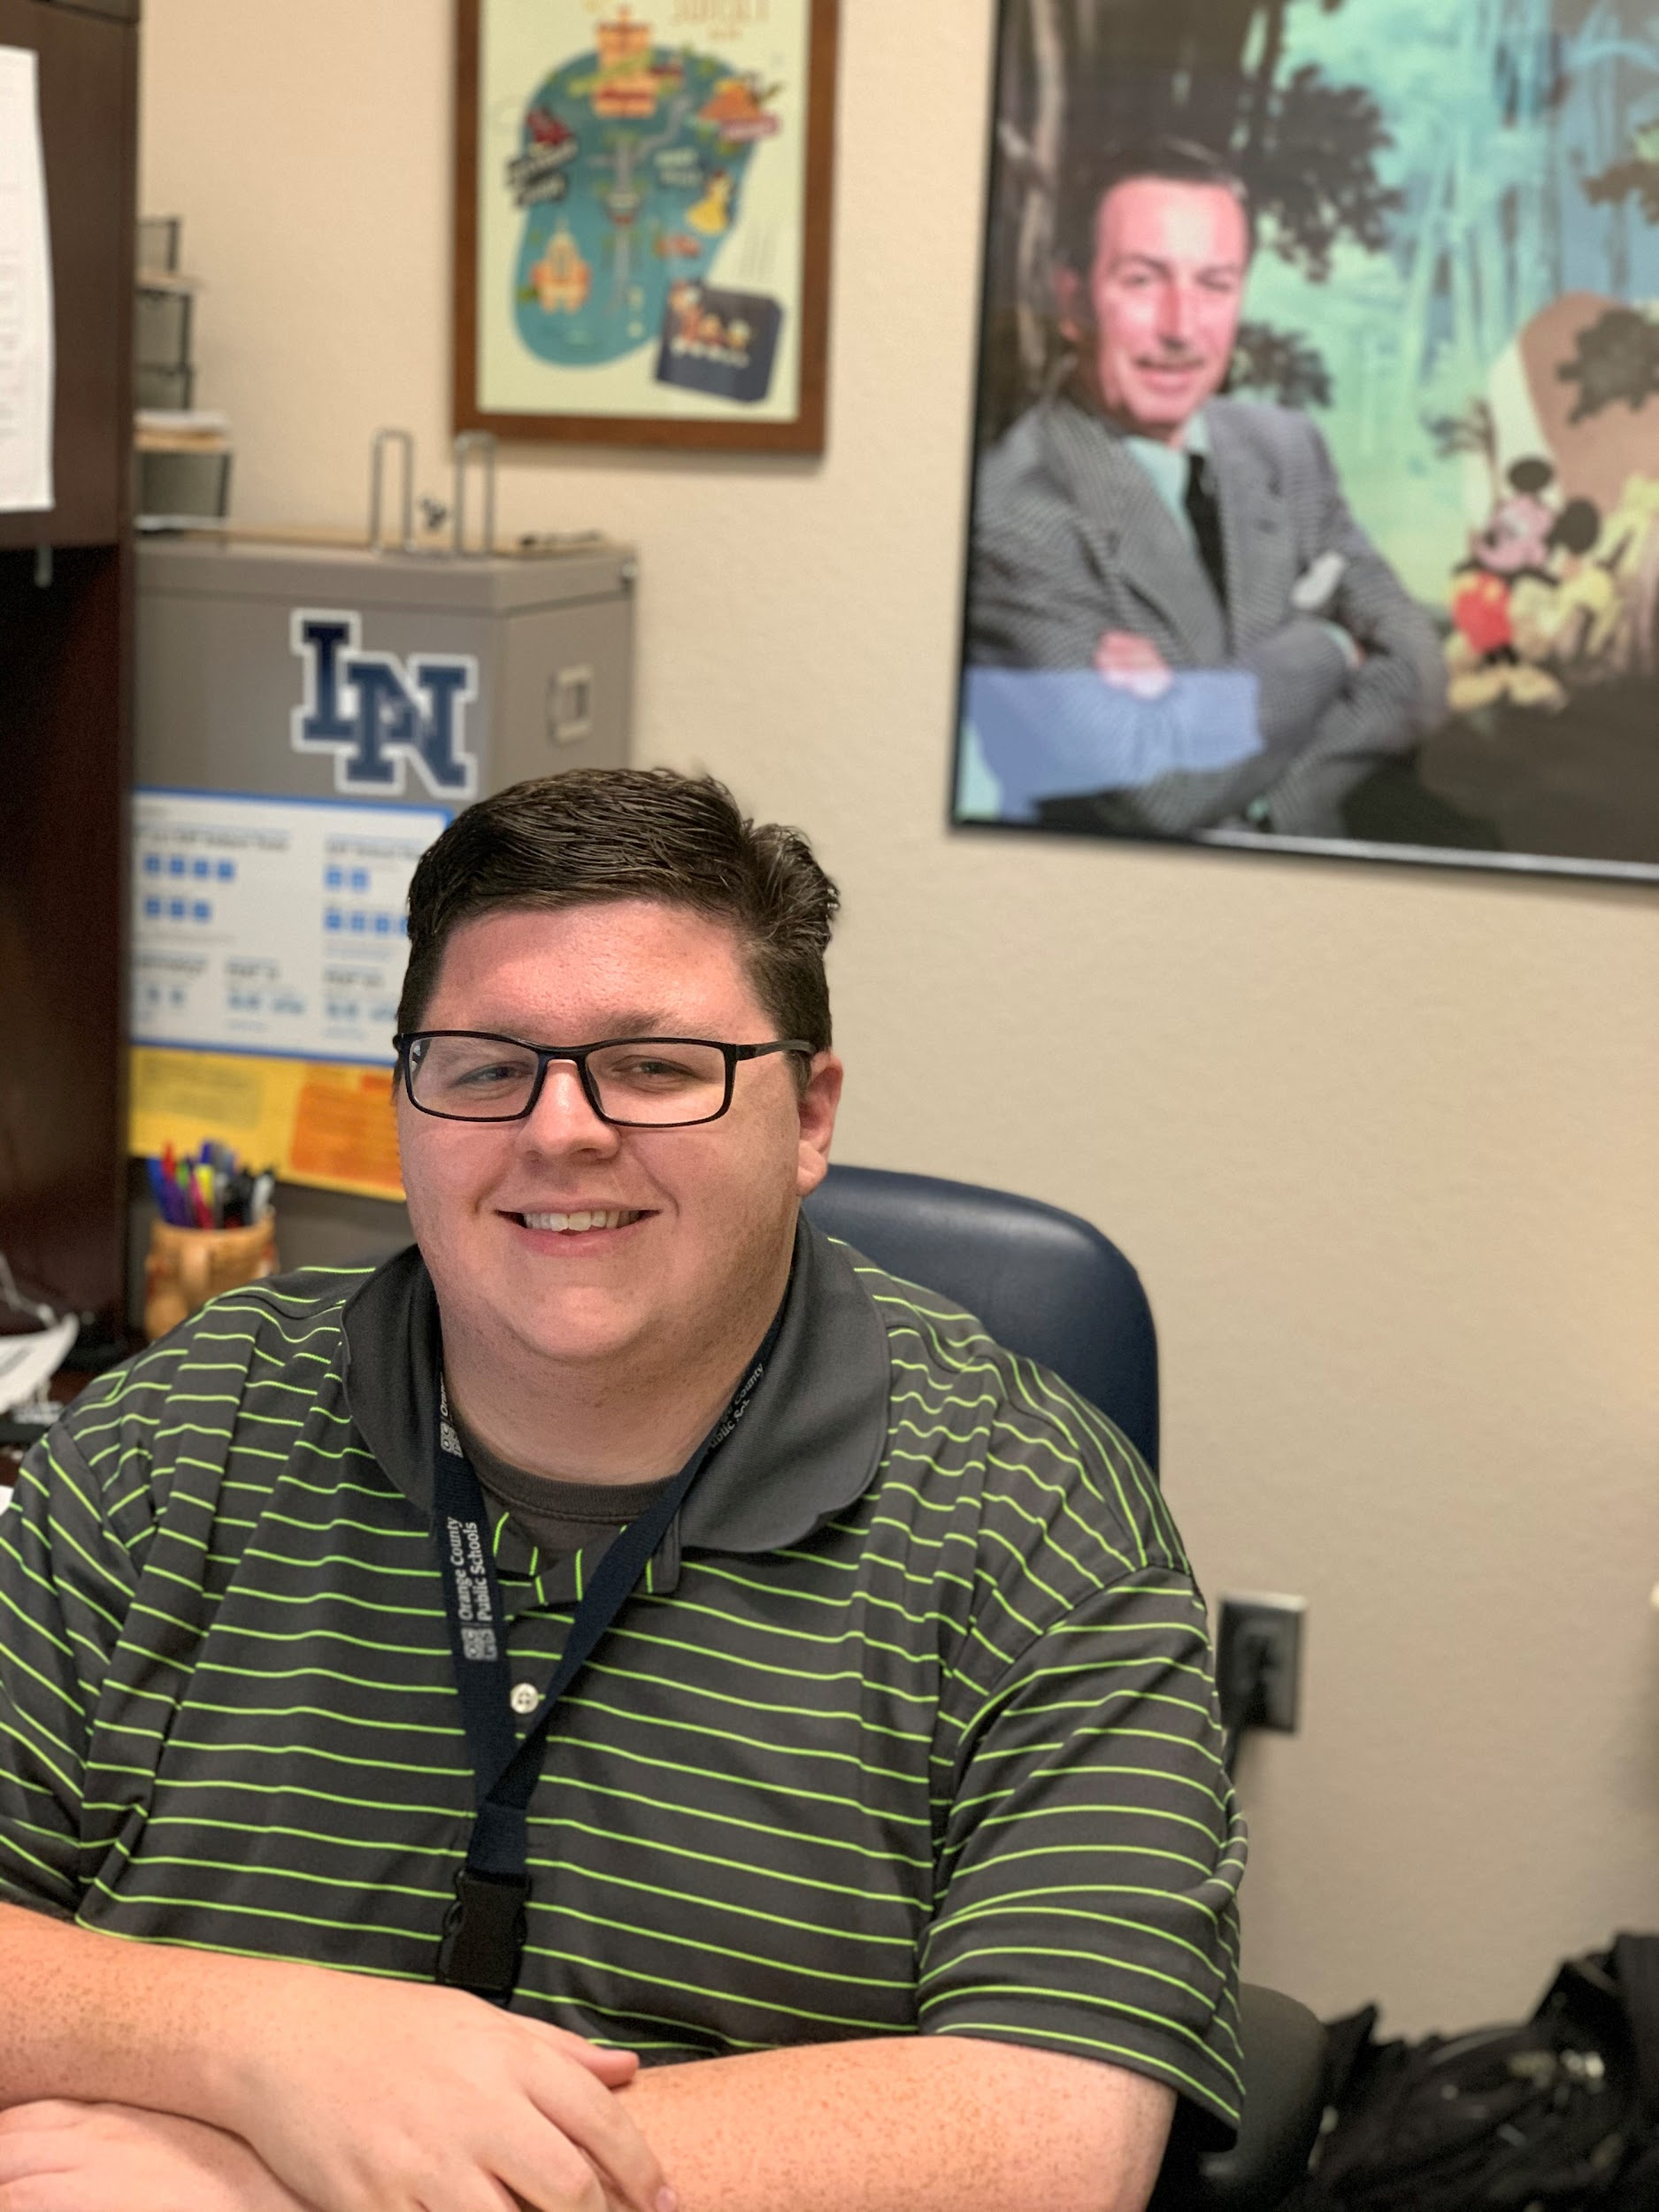
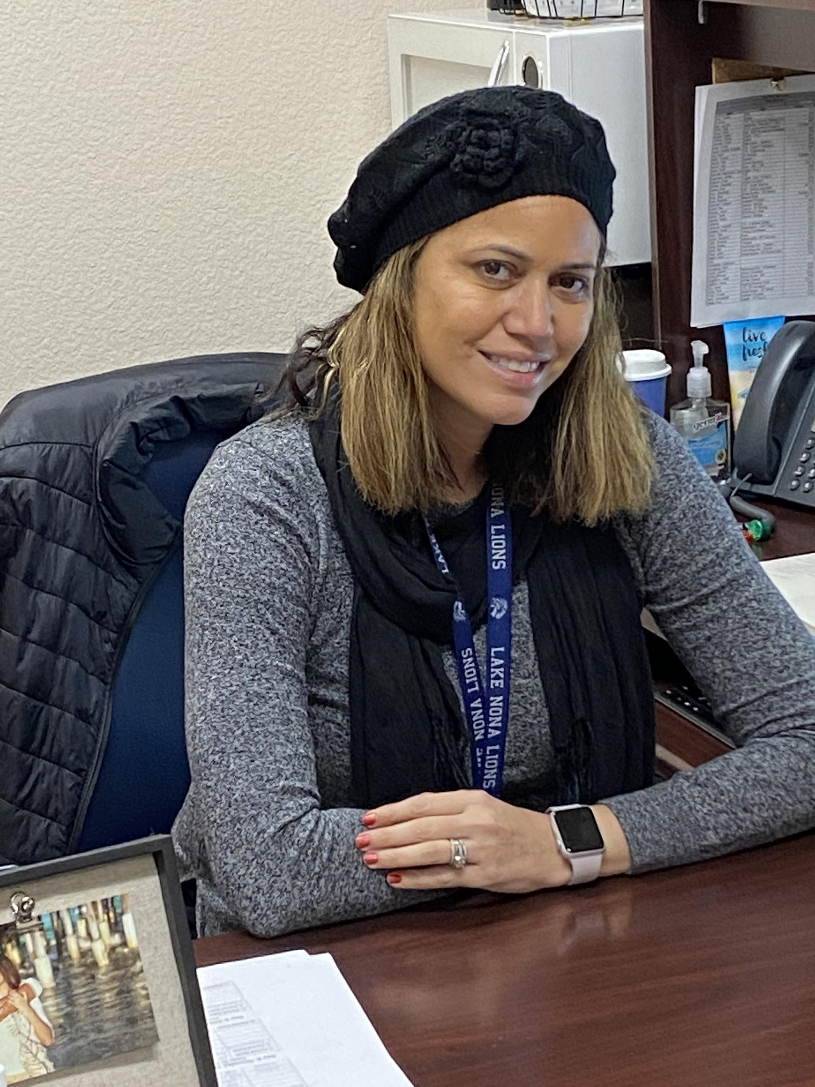
Student Services Team - 9th and 10th Grade Counselors
Ms. Pacheco
Last Name: A-B
Mr. Botchen
Last Name: C-Dom
Ms. Correa
Last Name: Don-Lop
Ms. Rivers
Last Name: Loq-Ram
Ms. Burke
Last Name: Ran-Z

Slide 3
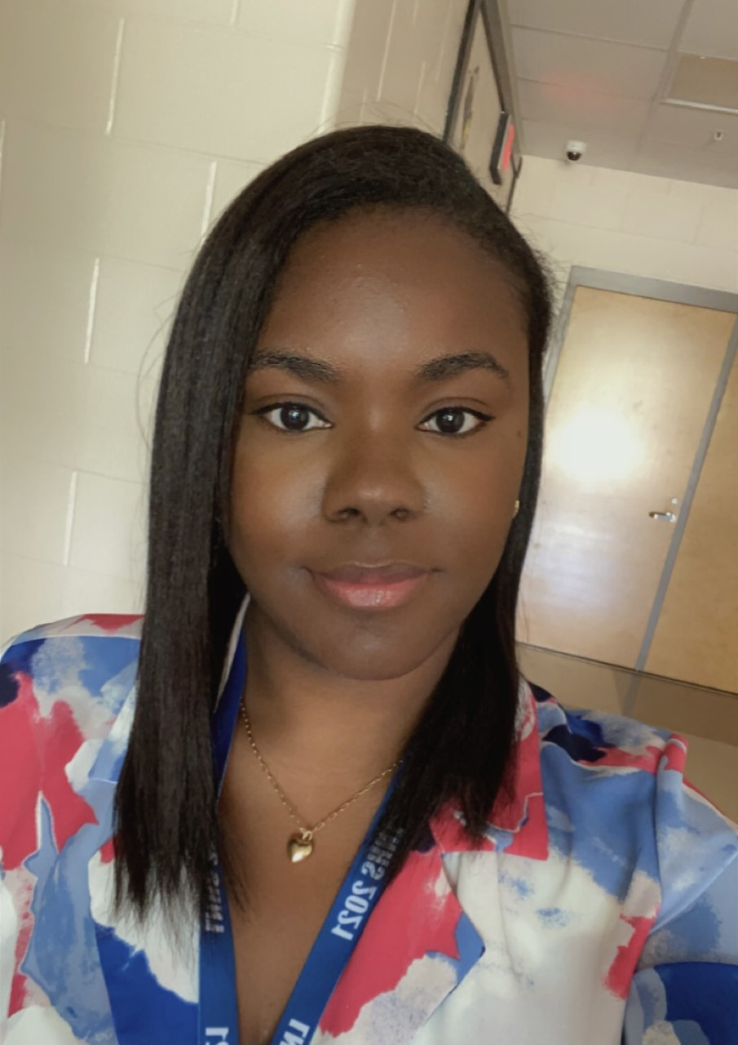
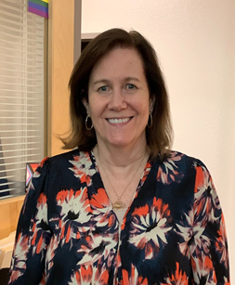
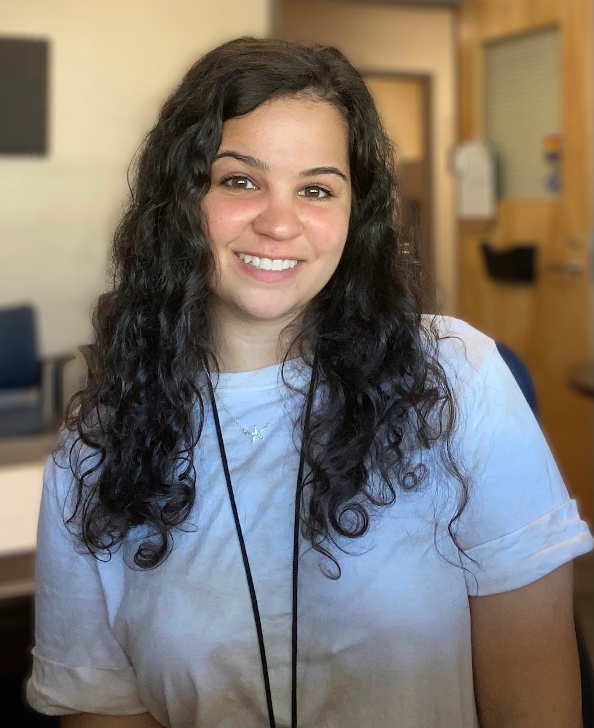
Student Services Team - 11th and 12th Grade Counselors
Mr. Botchen
Last Name: A-Con
Ms. Russell
Last Name:Coo-Hi
Ms. Kennedy
Last Name: Ho-M
Ms. Pacheco
Last Name: Sal-Z
Ms. Pinto
Last Name: N-Sak

Slide 4
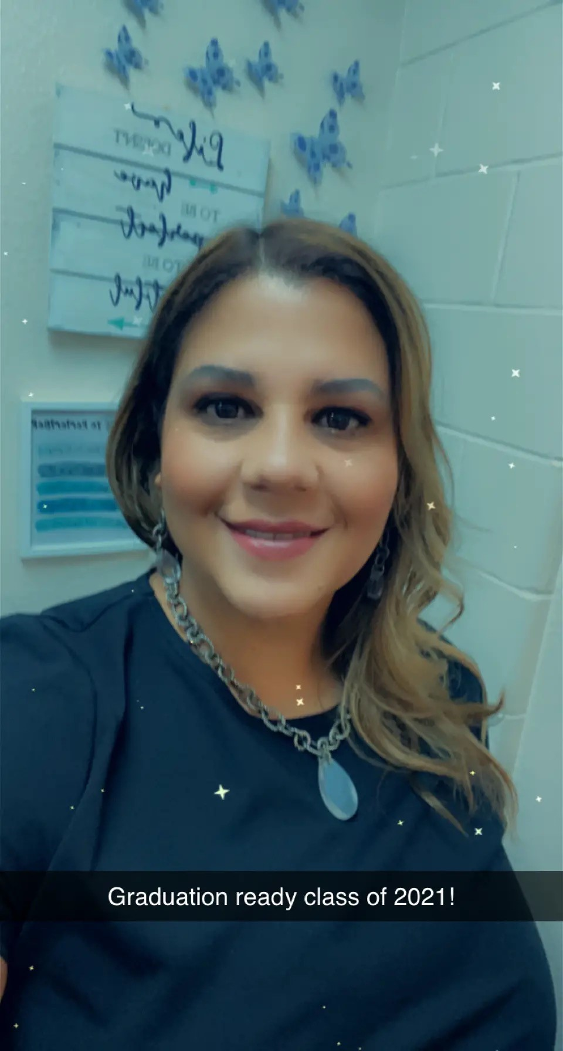
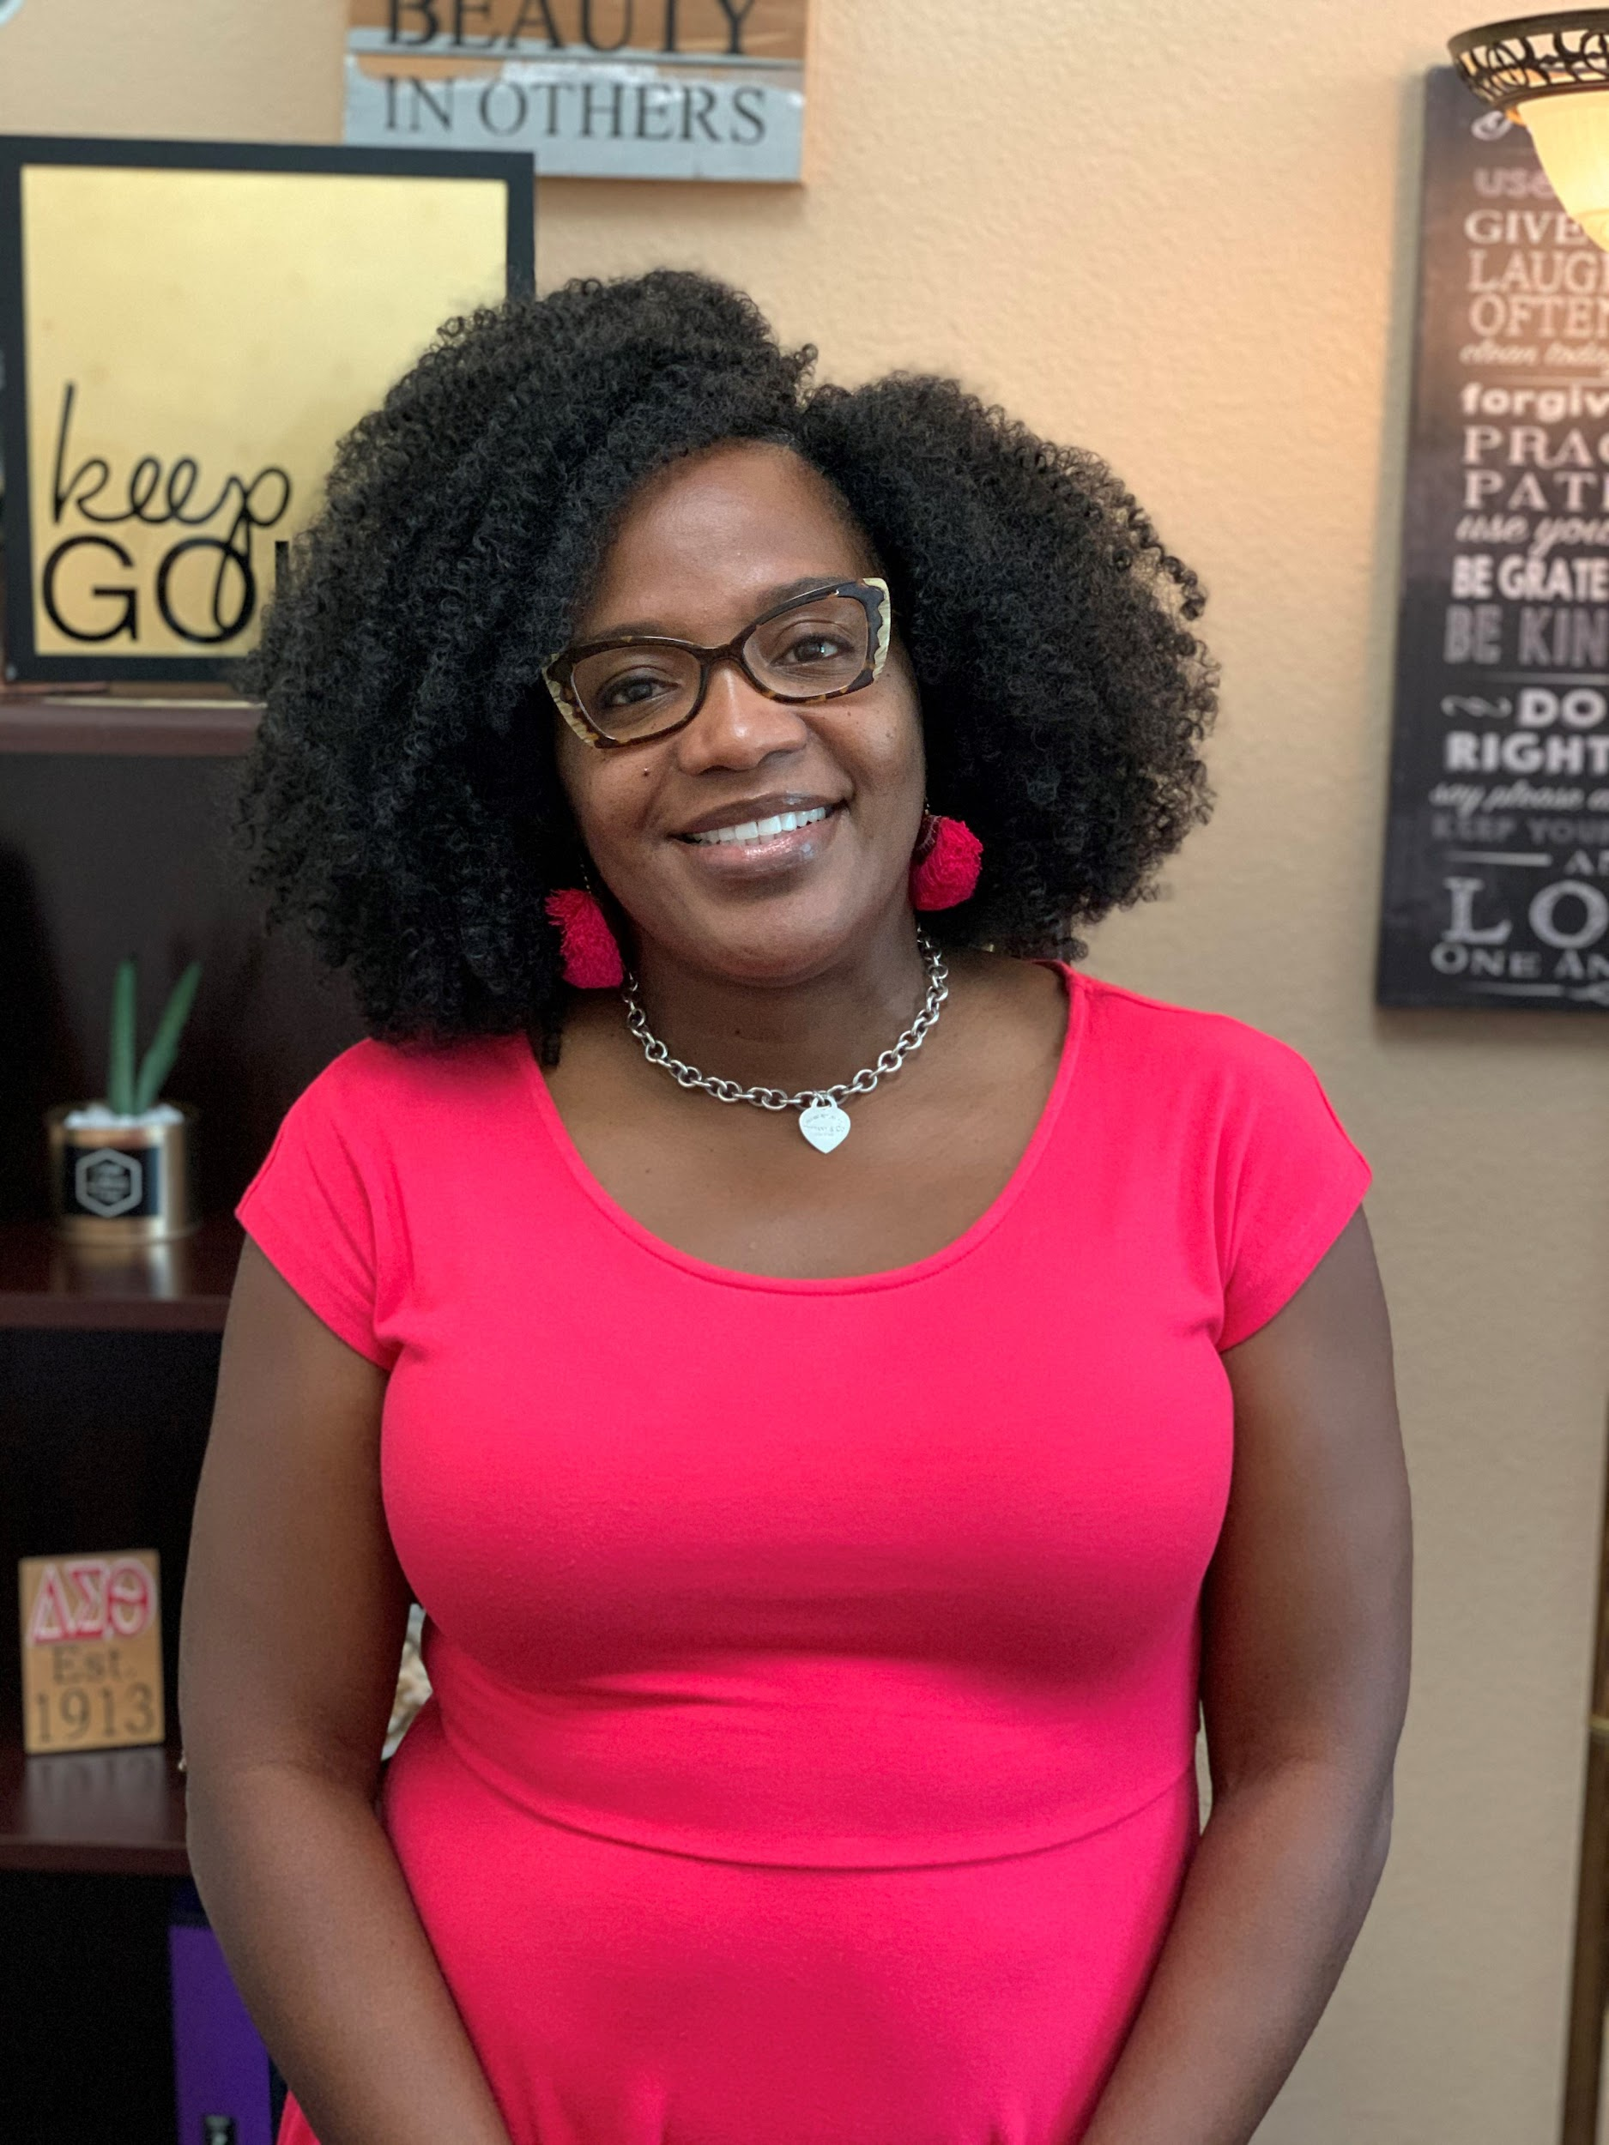
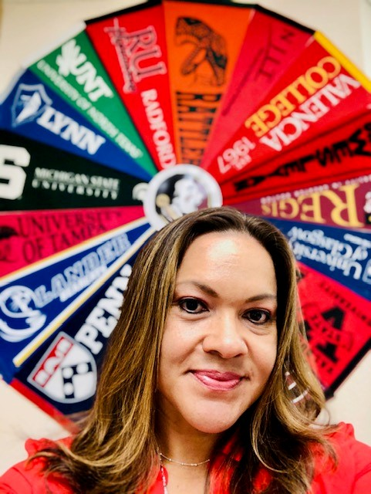
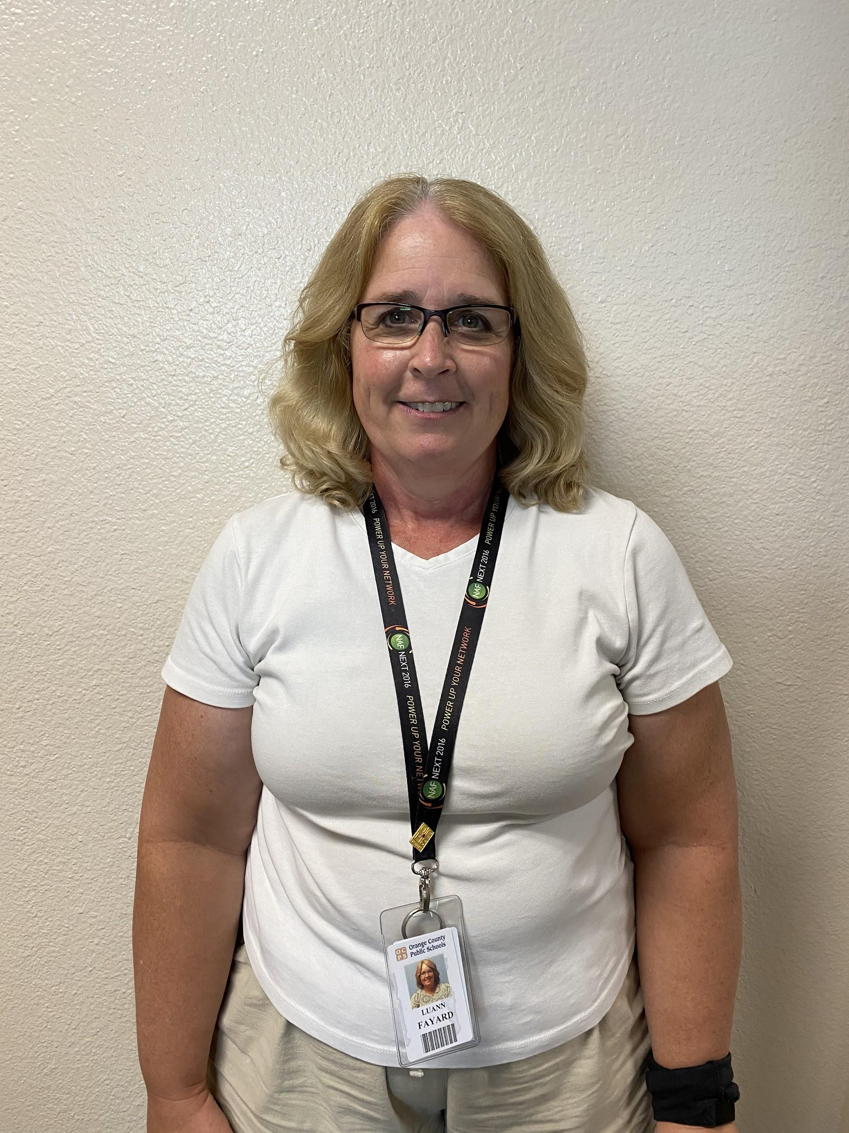
API, SAFE Coordinator, College and Career Specialist and Career Specialist
Tammy Whitfield
SAFE Coordinator
Mrs. Fayard
Career Specialist
Mrs. Rivera
Assistant Principal
of Instructions
Mrs. Harmon
College and Career
Specialist

Slide 5
GRADUATION REQUIREMENTS
Earn 24 credits
Passing score on FSA/ELA Reading (or SAT/ACT concordant score)
Passing score on Alg 1 EOC (or PSAT/SAT/ACT concordant score)
A cumulative unweighted GPA of 2.0 or better
Online course in its entirety
Sitting for and completing the Geometry, Biology, and US EOCs
Subject Area | Credit total
English | 4.0
Math- Alg 1/Geo | 4.0
Science - Bio | 3.0
Social Studies World Hist American Hist Amer Govt and Econ w/ Fin. Lit | 3.0
Practical/Fine Arts | 1.0
HOPE | 1.0
Electives | 8.0
World Language | 0
Notes:
In order to graduate, you need 24 specific credits: you need to pass English every year of high school, you also need to earn 4 math credits which includes at the minimum Algebra 1 and Geometry; you need 3 credits of science with one of them being that you must pass Biology. When it comes to Social Studies classes, you need 3 specific Social Studies classes (World History that students typically take in 10th grade, US History that students take in 11th grade, and in 12th grade, students take a semester of Economics and a semester of US Government. You also need 1 credit of a practical, performing, fine art class which could be Band, Chorus, Ceramics, Draw, Paint, Debate, Journalism, Digital Design, Digital Information Technology, or Introduction to Engineering. Students also need to pass HOPE, which should be an easy A as long as you are dressing out. In addition, you need 8 electives credits and as long as you are passing your classes, you will have more than enough by the time you graduate.
While it is not required for graduation,it is recommended that you complete 2 years of the same foreign language as colleges like to see foreign language credits and it is required for the Bright Futures Scholarship program.
In addition to the 24 credits, you also need to obtain a passing score on the 10th grade FSA ELA Reading exam. You will take the 9th grade FSA this year and it is a good measure of how you are doing, but the 10th grad one is required for graduation. If by chance you do not pass it in May of 10th grade, we will give it to you again twice in 11th grade and twice in 12th grade. You may also earn a corresponding score on the SAT or ACT. When it comes to the math testing requirement, you also will need to take and pass the Algebra 1 EOC with a level 3 achievement level or higher. You also have the opportunity of meeting the math graduation requirement by earning a concordant score on the Geometry EOC, or the math section of the PSAT, SAT, or ACT.
You also need to know that when it comes to your Geometry, Biology, Algebra 1, and US History class, 30% of your final grade in the classes come from the state End of Course exam. While you do not need to pass the Geometry, Biology, or US History exam to graduate (unless you are able to use the Geo EOC for Algebra 1 concordance) you do need to take it and try your best as long as you took the courses either in OCPS or online. If you are taking any of the classes online currently, please let your counselor know when you are 80% complete with semester 2. At this time, if you took any of the courses as a part of the 2019-2020 school year, the EOC testing for those classes is waived. If you want to earn the scholars diploma designation though, at this time you need to take and pass the corresponding EOC. Please let your counselor know you will need be placed on the list to test if you are interested.
You also need to earn a cumulative GPA of a 2.0 or higher meaning you want to try and earn at least a C in all of your classes. We will go more in depth tomorrow on the importance earning and maintaining as high of a GPA as possible.
Lastly, you will need to complete 1 online course in its entirety. This means whichever class you choose, you will need to complete the whole course. If the class is typically a full year course (English, Algebra 1, Spanish, Digital Information Technology) you will need to complete semester 1 and semester 2 of the online course for it to count. If it is a 0.5 credit course like Driver’s Ed, Peer Counseling, or Psychology 1 for example, you only need to complete the one and only segment for it to count as your online course. When you meet with your counselor in Spring to pick your classes for 10th grade, this will be one of the topics we discuss deciding when it the best time and which class you are thinking of taking

Slide 6
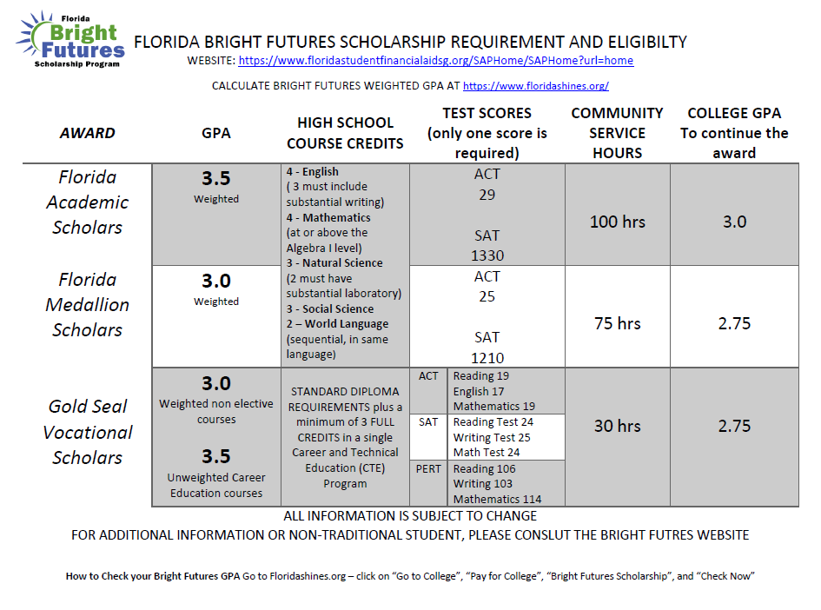

Slide 7
Grade Point Average
Only final grades are included in your GPA calculation. For full-year courses, semester grades will calculate a tentative GPA based on semester progress but the final GPA will recalculate for each class at the end of the year once final grades are awarded.
Unweighted | Weighted (Honors) | Weighted (AP & DE)
A = 4 B = 3 C = 2 D = 1 F = 0 | A = 5 B = 4 C = 3 D = 1 F = 0 | A = 6 B = 5 C = 4 D = 1 F = 0

Slide 8
The impact of 0 on student grades
Assignment 1 = 80
Assignment 2 = 0
Assignment 3 = 75
Assignment 4 = 60
Assignment 5 = 100
Assignment 6 = 0
Assignment 7 = 79
Assignment 8 = 0
Assignment 9 = 95
Assignment 10= 80
Total Points/# of Assignments
569/10 = 56.9
* This student earned an F for the 9 weeks
Assignment 1 = 80
Assignment 2 = 50
Assignment 3 = 75
Assignment 4 = 60
Assignment 5 = 100
Assignment 6 = 50
Assignment 7 = 79
Assignment 8 = 50
Assignment 9 = 95
Assignment 10= 80
Total Points/# of Assignments
719/10 = 71.9
* This student earned a C for the 9 weeks
Notes:
Have the students attempt to calculate this themselves on their worksheet before revealing the answer.
8

Slide 9
Transcript
The first page of a transcript will contain demographic information. Be sure yours has your correct legal name, address, social security number, and parent information!
To make corrections, please email Ms. Lally at Tia.Lally@ocps.net
Notes:
If you are not already, you should begin to get familiar reading a transcript. A transcript is a cumulative record of everything taken for high school credit, but the first section contains identifying demographic information. In the top left-hand corner of your transcript, you will see your Legal Name and Mailing Address. Please double check the spelling of your name. If you have multiple last names, please make sure we have both names listed. Review your address - this is the address we have on file. If it is incorrect, you will need to email Ms. Lally at Tia.Lally@ocps.net in order to update your address. Please review the remaining identifying information for accuracy and contact Ms. Lally as needed for corrections.

Slide 10
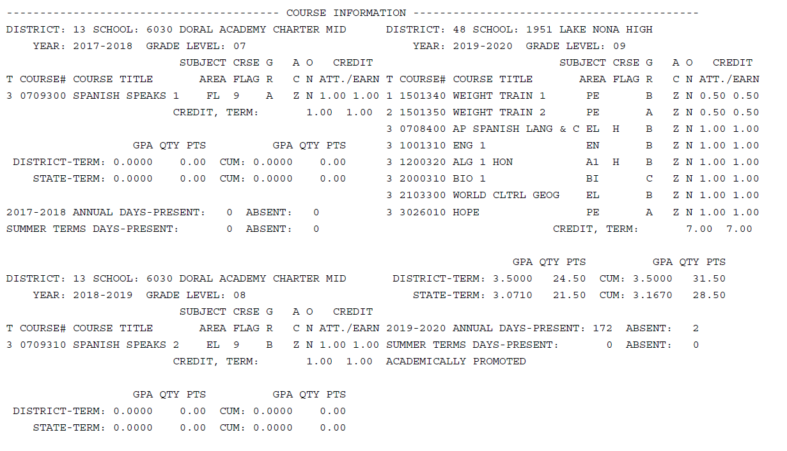
Name of School
Grade Level
H Flag= Weighted Class
Notes:
Below demographics, course information begins. See how it is listed in sections, with each section having a heading of the school where those credits were earned and a year/grade level. Then, under course title, you can see the actual classes. Follow along each line to see the grade that was “attempted/earned.” Note that some classes have a flag. We’ll discuss these flags more on the next slide...

Slide 11
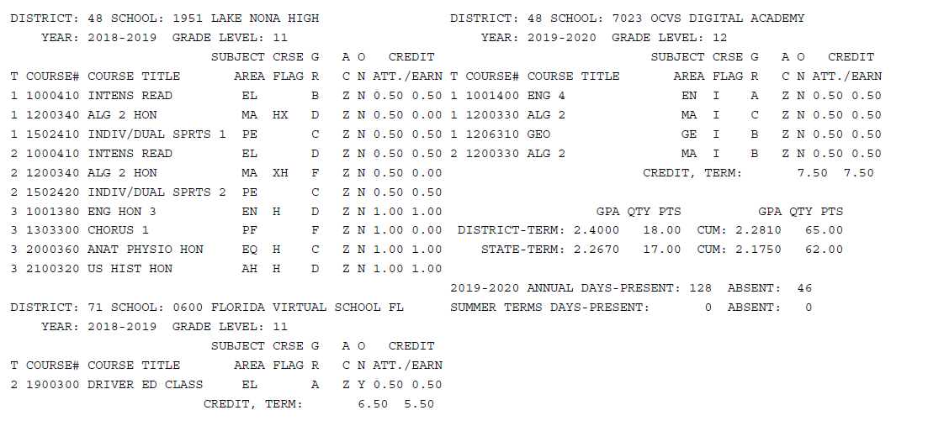
I Flag=
Class Retaken for Grade Forgiveness or Credit Recovery
Our Grade Forgiveness/Credit Recovery Program
(Edgenuity)
X Flag=
Grade Has Been Forgiven
Notes:
This student has a few X and I flags. This shows that a class was made up for either grade forgiveness or credit recovery. This can happen with many core classes that end with a grade of D or F. The original grade will never disappear from your transcript, but with a new grade, the lower one will no longer factor into your GPA.

Slide 12
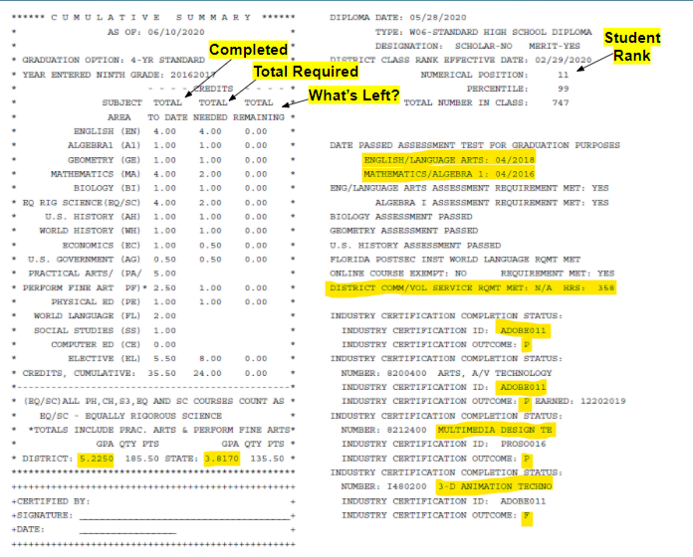
Online Course Indicator
Weighted GPA
Unweighted GPA
Notes:
This is what we call the summary page. Look at the box on the left: you can see by subject area how many credits of each are completed, required, and still remaining. This is a tool you can use to see what classes you personally still have left until you have met all graduation requirements. Towards the bottom of the box, you will see your cumulative weighted and unweighted GPA. On the right hand side, you can see your rank out of the total number of students in your grade level. Below that, you can see which assessments you have passed, followed by whether or not you have taken your online class, the number of community service hours you have, and any industry certifications you may have earned. P means passed and F means failed.

Slide 13
Best Practices for Parents to Encourage Student Success
Check Skyward and Canvas regularly. Is your student turning in assignments on time? How well is your student testing? Check your student’s attendance (and potential tardies). Keep open communication with your child regarding grades and assignments.
Encourage your child to communicate directly with their teacher (via email). You may also contact your student’s teachers. Teachers’ email addresses are located on the school website under the Faculty & Staff tab.
Lastly, if you need further assistance, contact your student’s school counselor and provide the counselor with your email communication with the teacher to best support the situation.
**Remember that the end goal is not just about the grade. Students should be working to develop academic and self-advocacy skills as well as problem-solving abilities.

Slide 14
Parent teacher conferences
If an issue arises with a specific course or teacher, please reach out to them directly for the opportunity to resolve the issue. A directory of staff emails is located on our school website.
If your student is struggling in multiple courses, please reach out to their assigned counselor to set up a virtual conference.
We will use Microsoft Teams or Webex to virtually connect with our students and parents.
Once the conference is scheduled, a link will be sent to the student/parent and all invited teachers with the date/time of the conference.

Slide 15
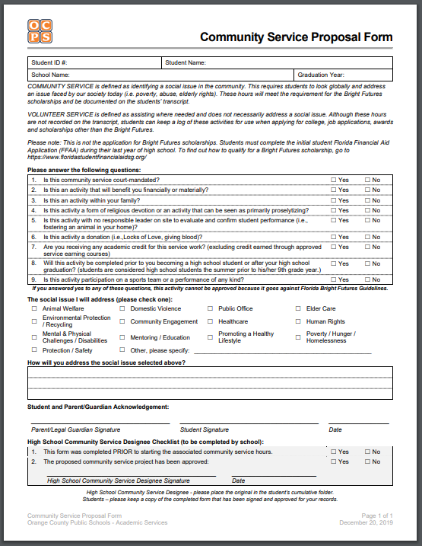
Community Service Plan
The Community Service form can be found on the LNHS school website, under the Student Services tab, click Community Service
The Organization and Pre-Essay must be approved before student can begin serving the organization. You will upload your documentation to the Student Services tab in the Lions Den course on CANVAS.
All hours MUST be turned in by the last day of school EACH year.

Slide 16
Dual Enrollment programs
MEET PARTICIPATION REQUIREMENTS:
3.0 unweighted cumulative GPA for grades 6 – 11 or 3.0 weighted high school cumulative GPA for high school seniors at time of application.
Obtain eligible college-ready test scores through the PERT, ACT and/or SAT
PERT
Reading: 106 – Writing: 103 – Math: 114 (College Mathematics or Intermediate Algebra) – Math: 123 (College Algebra or Statistical Methods)
ACT
Reading: 19 – English: 17 – Math: 19 (Intermediate Algebra) – Math: 21 (College Algebra or Statistical Methods)
SAT
Critical Reading: 24 – Writing: 25 – Math: 24 (Intermediate Algebra) – Math: 26.5 (College Algebra or Statistical Methods)
Must maintain minimum 3.0 GPA in high school and minimum 2.0 GPA each semester at Valencia College.
►Has to be a Junior or Senior
►3.6 unweighted high school GPA
►One of the following test scores:
►SAT 1100 composite
►PSAT 1130 composite
►ACT 22 composite

Slide 17
Dual Enrollment
Students interested in dual enrollment (part-time enrollment) or early admission (full-time enrollment) prior to high school graduation must meet or exceed the following academic qualifications:
Be enrolled as a student in a Florida public or nonpublic secondary school or in a home education program** (grades 6-12)
Have a minimum 3.8 high school GPA (as re-calculated by UCF using only academic core courses).
Present SAT or ACT scores of at least:
SAT: 1330 (Evidence-based Reading and Writing + Math)
ACT: 28 (Composite)

Slide 18
AP Classes v/s Dual Enrollment
AP Classes
Colleges tend to award credit more easily based on AP test scores (typically 3 or higher)
Academically challenging classes
Out-of-state tuitions tend to look more favorably on AP classes because the curriculum is familiar
Helps increase weighted GPA.
No guarantee college credit will be awarded by passing the class, student must achieve the required test score
Dual Enrollment
Students have experience with a college setting while in high school.
Save money towards earning a degree.
Helps increase the weighted GPA.
The student is the only one that can advocate for him or herself. Parents must be “hands off”.
More variety of classes.
Students are able to experience different campuses.

Slide 19
Pros and Cons of Dual-Enrollment (on track to graduate with an AA)
Pros
For in-state institutions, it can shorten the time to complete undergraduate degree.
Students have experience with college scheduling and classes while in high school.
Save money towards earning a degree.
Ability to satisfy high school requirements as well as AA degree requirements.
Cons
There is no guarantee all credits will count for an AA degree earned while in high school. It is up to the institution to decide how many credits they will accept.
Can cause issues with future employment if the student is too young and has no job experience.
A major must be declared once student starts college. If student is unsure of what they want to study, this can cause issues for them.
Dual Enrollment is NOT a direct connect to any institution. Students must still apply to the college as a first time college student, not a transfer student.

Slide 20
Dual Enrollment at Orange Technical College
Rising Junior or Senior
At least a 2.0 unweighted GPA
On track for graduation
Three free elective periods available in your schedule
While at the tech college campus, you are engaged in hands-on learning taught by industry professionals.
You can also gain industry certifications while earning dual enrollment credit.
It can mean a higher starting wage for a high school graduate.
Lake Nona Career Specialist:
LuAnn Fayard (LuAnn.Fayard@ocps.net)
Room 508A

Slide 21
Acceleration
In addition to scheduling all students in correct class placements and elective choices, we work hard to ensure students have at least one opportunity each year to earn an acceleration credit. This helps ensure our students are college and/or career ready once they leave Lake Nona HS.
An acceleration credit is earned by passing an AP exam, earning a dual enrollment credit, and/or passing an industry certification exam.

Slide 22
CTE courses offering industry certifications
Below is a list of CTE courses and non-CTE courses that offer an industry certification that will lead to an acceleration point:
Agriscience Foundations, Horticulture 2 and 3
3D animation Production Assistant (Animation 1), Modeler (Animation 2) and Texture Artist/Rigger (Animation 3)
Digital Media 1
Digital Design 2, and 3
Digital Video Technology 2, 3 and 4
Introduction to Engineering,Aerospace and Civil Engineering & Architecture
Electrocardiograph Technician 3
AP Computer Science Principles
AP Computer Science A
Journalism
Criminal Justice

Slide 23
Super Scholar Institutions
Top 20 National Universities 2021
1.Princeton University 11.Northwestern University
2.Harvard University 12.Duke University
3.Columbia University 13.Dartmouth College
4.Massachusetts Institute of Technology 14.Brown University
5.Yale University 14.Vanderbilt University
6.Stanford University 16.Rice University
7.University of Chicago 16.Washington University St. Louis
8.University of Pennsylvania 18.Cornell University
9.California Institute of Technology 19.University of Notre Dame
10.Johns Hopkins University 20.University of California-Los Angeles

Slide 24
Super Scholar Institutions
Top 20 Liberal Arts Colleges and Universities 2021
1. Williams College 9. Middlebury College
2. Amherst College 9. Washington and Lee University
3. Swarthmore College 13. Grinnell College
4. Pomona College 13 Vassar College
4. Wellesley College 15. Colby College
6. Bowdoin College 15. Davidson College
6. Claremont McKenna College 15. Haverford College
6. US Naval Academy 15. Smith College
9. Carleton College 15. United States Military Academy
9. Hamilton College 20. Colgate University
*All U.S. Service Academies, in addition to those ranked above, to include:
Air Force, Coast Guard, and Merchant Marine.

Slide 25
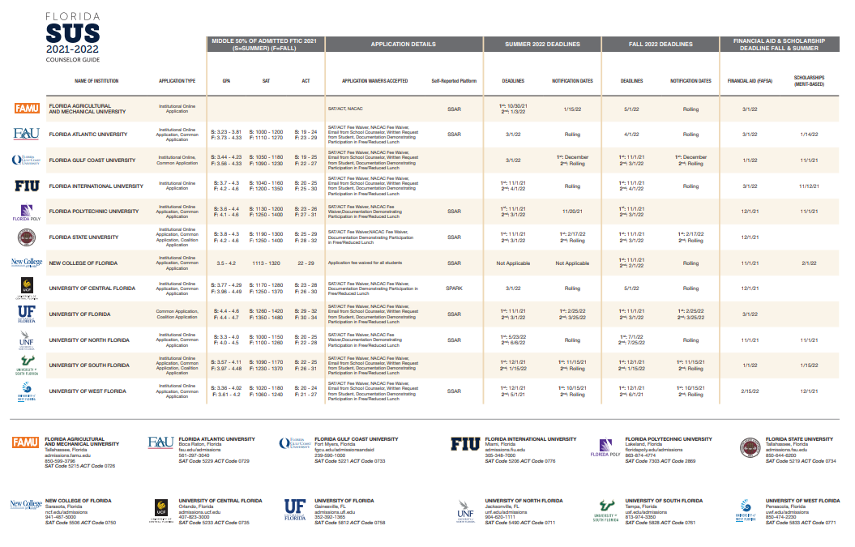
Florida Public Universities

Slide 26
Counselor Meeting Request
Students may request a meeting with their counselor at any point throughout the year via the Counselor Meeting Request Form or via email (Counselors have 48-72 business hours to communicate back with the parents and students). Students must be signed in to their OCPS account for access. When possible, meetings will be virtual.
9th and 10th Grade School Counselors
Ms. Pacheco (A-B) Alana.Pacheco@ocps.net
Mr. Botchen (C-Dom) Alexander.Botchen@ocps.net
Ms.Correa (Don-Lop) Melinda.Correa@ocps.net
Ms. Rivers (Loq-Ram) Monique.Rivers@ocps.net
Ms. Burke (Ran-Z) Tabitha.Burke-Schiffhauer@ocps.net
11th and 12th Grade School Counselors
Mr. Botchen (A-Con Alexander.Botchen@ocps.net
Mrs. Russell (Coo-Hi) Belindha.Russell@ocps.net
Ms. Kennedy (Ho-M) Shirley.Kennedy@ocps.net
Ms. Pinto (N-Sak) Brittany.Pinto@ocps.net
Ms. Pacheco (Sal-Z) Alana.Pacheco@ocps.net

